Slide 1
How To Learn Python
For
Data Science

Slide 2
Basic Syntax
Writing Basic Programs
Operators (Arithmetic, Relational, Logical, Membership)
If - else statements
Loops(Specially For loops, Nested Loops)
Functions
Estimated Time - 2-3 Days

Slide 3
Data Types
Lists
Strings
Dictionary
Working with Dates
Estimated Time - 2-3 Days

Slide 4
Bit of Functional Programming
Lambda Functions
Map, Filter and Reduce
Higher Order Functions
Estimated Time - 1 Day

Slide 5
Advance Concepts
File Handling
Exception Handling
Regular Expressions
Estimated Time - 2-3 Days

Slide 6
Good to haves
Basic Understanding of OOP
Flask
Experience with external Libraries(installing and using)
Estimated Time - 7 Days

Slide 7

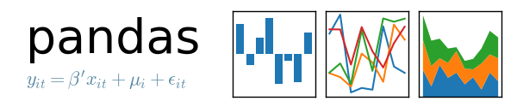
External Libraries
Estimated Time - 2+5 Days

Slide 8
Understand How To Represent Data
Real World Data
Text, Images and Videos
Working with Data Formats like CSV and JSON
Estimated Time - 2 Days

Slide 9
The Big Questions
Do we need to learn Data Structures and Algorithms?
Do we need to dive deep?

Slide 10
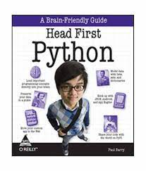

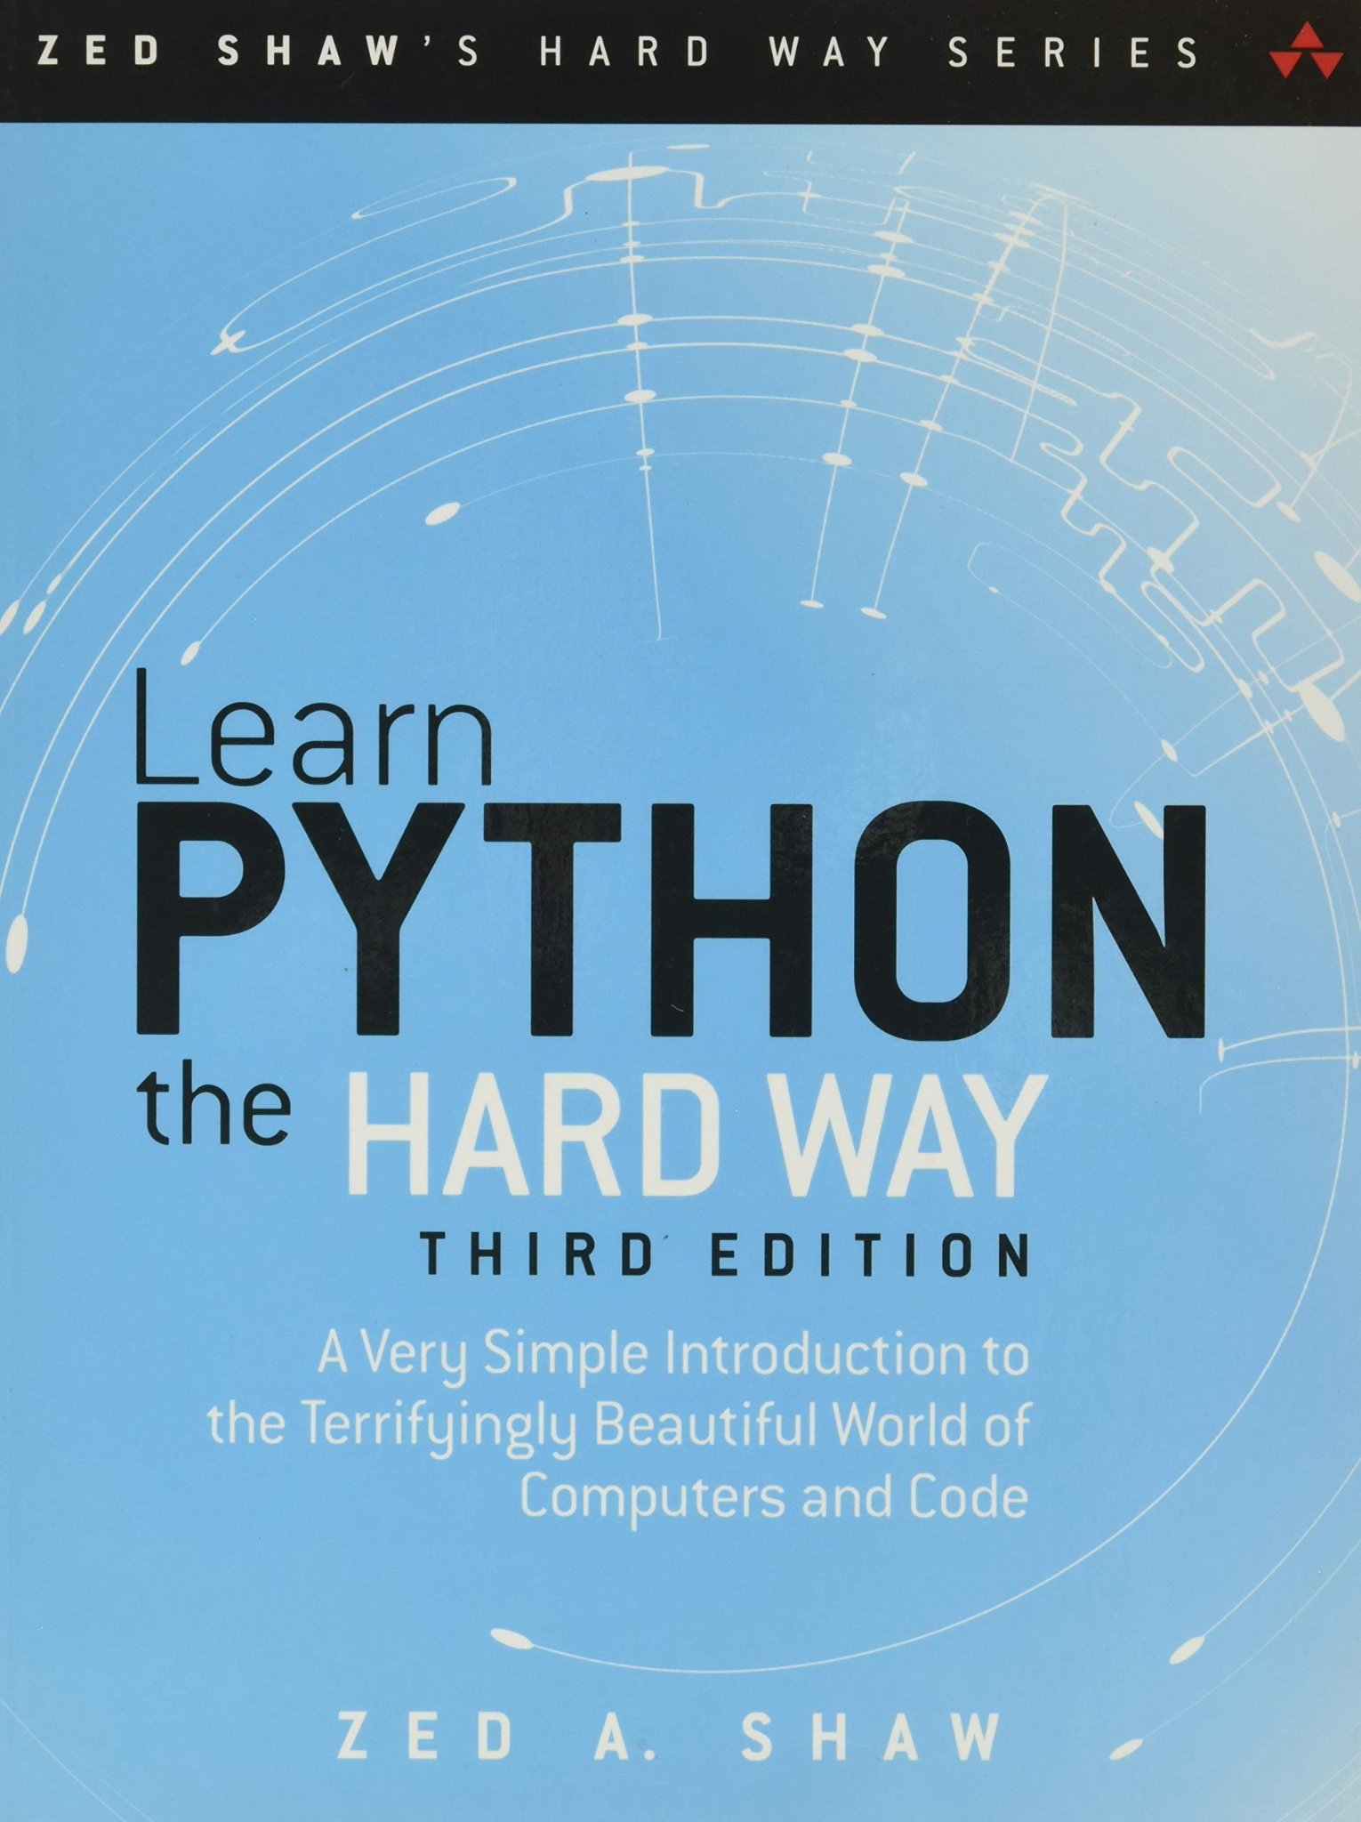
Learning Resources
Official Python Docs
Books:

Slide 11


Learning Resources
Website - www.programiz.com
YouTube Channels -

Slide 12
My Advise
Learn by doing
Don’t try to follow entire syllabus

Slide 13
How To Learn SQL
For
Data Science

Slide 14
What is SQL
Structured Query Language
SQL is designed for managing data in a relational database management system (RDBMS). SQL is a database language, it is used for database creation, deletion, fetching rows, and modifying rows, etc.

Slide 15
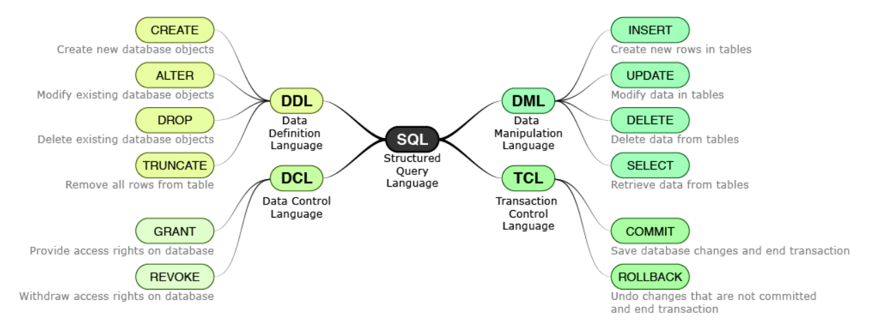
What is SQL

Slide 16
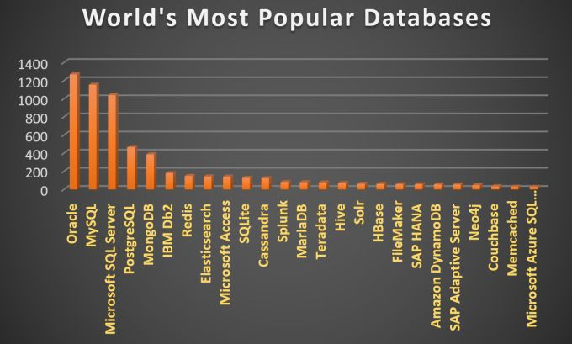
Why is SQL so important?
Cloud Technologies
Big Data Technologies

Slide 17
Why is SQL important in Data Science?
The not so evolved Data ecosystem.
Initial Understanding of the data

Slide 18
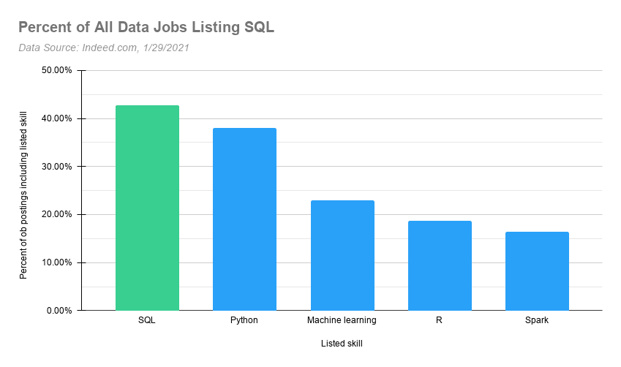
Why you should learn SQL?
Data Scientist
Data Analyst
Data Engineer

Slide 19
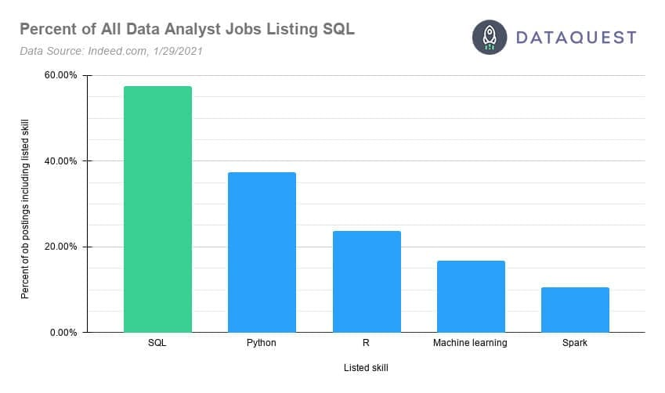
Why you should learn SQL?
Entry-level Jobs

Slide 20
FAQs
Is it hard to learn SQL?
Which database should we choose?

Slide 21
What exactly to learn?
DML Commands - INSERT, SELECT, DELETE, UPDATE, WHERE, ORDER BY
SQL Joins
Subquery and temp tables
SQL Cases
Stored Procedures and Functions
Window Functions

Slide 22
What exactly to learn?
Data types
Normalization and Denormalization
Indexing
Query Optimization Practices
Schema Design (Creating Databases and Tables)

Slide 23
Resources

Slide 24
My Advise
Practice a lot
Don’t just learn to crack interviews

